Slide 1
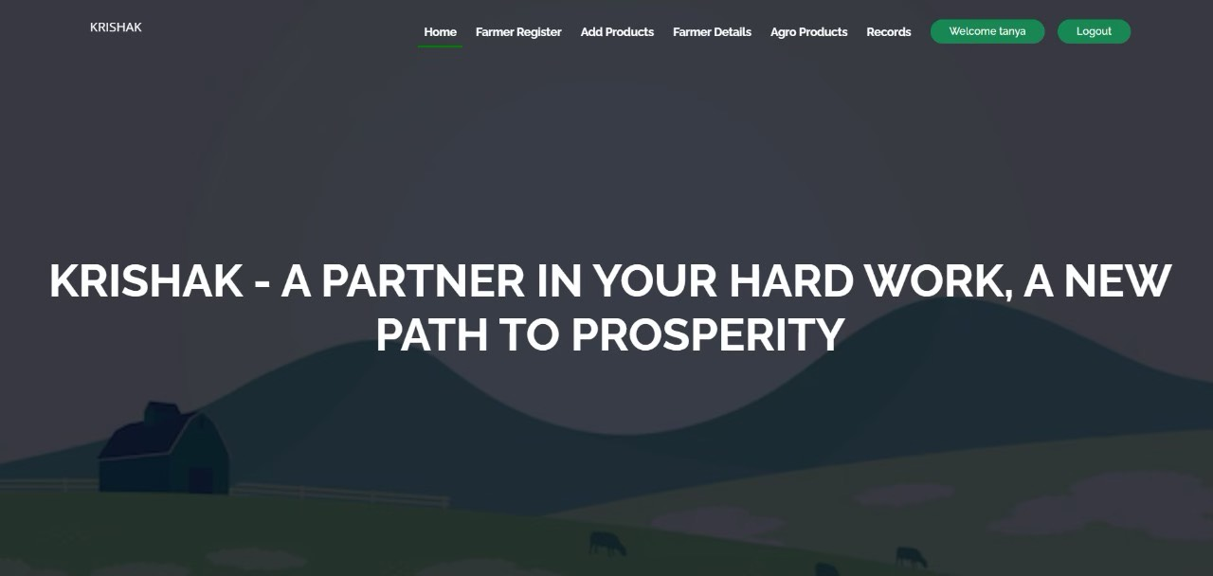
KRISHAK An Integrated Agricultural Equipment Sharing and Resource Optimization Platform for Farmers
by Tushtee Singh(2100290120176)
Surabhi Agnihotri(2100290120169)
Kushagra Singh (210029020099)
Nancy Srivastava(2100290120109)

Slide 2
Project Abstract
Overview
Krishak is a web-based platform designed to help small and medium-sized farmers access affordable agricultural machinery. By integrating technology-driven farm equipment sharing, intelligent scheduling algorithms, and community-driven initiatives, Krishak aims to optimize resource utilization and enhance sustainable farming practices.
Key Objectives
Provide farmers with affordable access to essential agricultural machinery.
Improve resource efficiency through optimized scheduling and reduced downtime.
Foster collaboration among farmers, equipment owners, and service providers to promote sustainable agriculture.
Approach
Krishak is built with HTML, CSS, JavaScript for the front-end, Python Flask for the back-end, and an SQL database for secure data management. It follows an agile approach, ensuring secure authentication, real-time updates, and a user-friendly interface.
The platform connects farmers with buyers and equipment providers, enabling secure transactions, seamless communication, and scalable growth through optimized data management and intuitive features.

Slide 3
Project Goals and Objectives
1. Accessible Agricultural Equipment
Establish a platform that enables farmers to rent agricultural machinery at affordable rates, reducing the financial burden of equipment ownership.
2. Efficient Resource Utilization
Develop intelligent scheduling algorithms to optimize farm equipment use, ensuring minimal downtime and increased operational efficiency.
3. Community Empowerment
Foster collaboration between farmers, equipment owners, and service providers to create a self-sustaining ecosystem for agricultural development.

Slide 4
Alignment with UN Sustainable Development Goals (SDGs)
SDG 8: Decent Work and Economic Growth
Boosts rural economies by improving access to modern agricultural tools and increasing productivity.
Krishak empowers rural economies by providing farmers with access to modern agricultural tools and equipment. This leads to increased productivity, reduces manual labor dependency, and improves income stability. By streamlining transactions between farmers and equipment providers, Krishak enhances financial opportunities and encourages entrepreneurship in the agricultural sector.
SDG 9: Industry, Innovation, and Infrastructure
Uses technology to drive agricultural innovation and enable efficient farming practices.
Krishak leverages technology to modernize agriculture by creating a digital marketplace for farming equipment and services. The platform connects farmers with essential resources, ensuring efficient allocation of tools and machinery. By integrating data-driven insights and real-time updates, Krishak fosters innovation in agricultural practices, leading to improved efficiency and sustainable farming methods.
SDG 12: Responsible Consumption and Production
Optimizes equipment use to reduce idle time and environmental impact.
The platform promotes optimal use of agricultural equipment, reducing unnecessary idle time and wastage. By facilitating shared access to resources, Krishak minimizes the need for excessive machinery purchases, which helps conserve materials and reduce environmental impact. This responsible approach to consumption ensures sustainable production practices in the agricultural sector.
SDG 17: Partnerships for the Goals
Strengthens collaboration between farmers, equipment owners, and stakeholders to enhance service delivery.
Krishak strengthens collaboration between farmers, equipment owners, government agencies, and agricultural stakeholders. By fostering partnerships, the platform creates a well-connected ecosystem that enhances service delivery, promotes knowledge sharing, and supports policy initiatives for sustainable farming. These partnerships ensure that agricultural communities can collectively work toward long-term economic and environmental sustainability.

Slide 5
Methodology and Approach
Agile Development Methodology
The platform was developed using an iterative approach with continuous feedback and improvements.
Technology Integration
Implemented a user-friendly web platform with scheduling algorithms and secure payment systems.
Data Analysis
Assessed the specific needs of farmers regarding equipment and rental demand to optimize service offerings.
Community Engagement
Encouraged farmer participation through training sessions, knowledge-sharing initiatives, and workshops on sustainable farming practices.

Slide 6
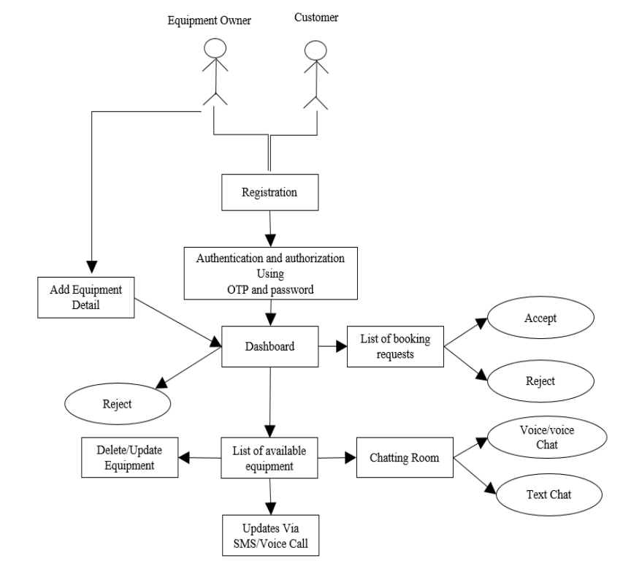
Work Flow Diagram

Slide 7
Expected Outcomes and Impact
1. Increased Access to Agricultural Equipment
Provides small and medium-sized farmers with greater access to essential farm machinery.
Reduces dependence on traditional and inefficient farming methods.
Enhances mechanization, leading to higher crop yields and efficiency.
2. Cost-Effective Farming
Promotes shared access to expensive agricultural equipment, reducing ownership costs.
Minimizes operational expenses by optimizing resource utilization.
Improves financial sustainability for farmers by lowering upfront investments.
3.Community Empowerment
Encourages collaboration among farmers, fostering a strong agricultural network.
Facilitates knowledge-sharing on best practices and modern farming techniques.
Strengthens rural economies by improving productivity and market access.

Slide 8
Key Project Deliverables
Agricultural Equipment Access – Providing essential farming tools on a rental basis.
Sustainable Farming Practices – Encouraging environmentally friendly and resource-efficient farming techniques.
Community Engagement – Conducting training sessions to educate farmers on efficient agricultural practices.

Slide 9
Next Steps and Conclusion
1. Scale and Expand
Extend the platform to more rural and semi-urban regions to maximize farmer outreach.
Enhance accessibility by integrating multiple regional languages for user-friendly interaction.
Develop mobile and offline accessibility features to ensure broader usability.
2. Forge Partnerships
Collaborate with agricultural organizations, local authorities, and technology providers to enhance platform efficiency.
Establish connections with financial institutions to offer subsidies or loan options for farmers.
Engage with research institutions to introduce data-driven insights for better farming practices.
3. Monitor and Evaluate
Implement data analytics to track user engagement and identify key areas for improvement.
Conduct periodic surveys and feedback sessions to enhance user experience and address challenges.
Introduce AI-driven recommendations for equipment usage and farming techniques to optimize agricultural productivity.

